Slide 1
Lesson 1: Crafting Effective Prompts for Copilot
Mastering prompts to enhance productivity and outcomes

Slide 2

Meet Your Presenter
Khalaf Haddad
Principal, Imua Learning
Over three decades of Technical Training, Leadership and Professional Development Experience
Published Author
Interests: History, General Aviation, Distance Running
Fun Fact: Khalaf and his wife are enjoying their first grandchild born in April 2024!

Slide 3
Pearson’s Copilot Training
Connecting the dots across Pearson’s AI Strategy

Slide 4


Introductory Session (1 hour session)
Job Family and Job Cateogry-Based Application Session
(4x 1 hour sessions)
Ongoing AI Upskilling
Copilot Vision
M365 Application
Practical Application
Ongoing AI Upskilling
Pearson's AI Vision
Overview of the M365 Copilot applications
At the end of the session, Copilot Champions will provide day to day examples of things they want to see how Copilot might help which will be used as demos in Phase 2
Each session will cover relevant M365 Applications and Copilot
Sessions will have exercises designed to align with 11 job groups
At the end of the 4 sessions, attendees will be awarded the Microsoft badge for MS-4004​
A Pearson Copilot badge will also be awarded

Slide 5

Badges

Slide 6
Outline
1
Introduction to Prompt Writing
2
Core Elements of an
Effective Prompt
3
Best Practices for
Prompt Writing
4
Practice Exercises

Slide 7
Introduction to Prompt Writing
Notes:
Lesson objectives and audience, Introducing Copilot and its role, Importance of prompt engineering

Slide 8

What is Prompt Writing?
Prompt = The instructions given to Copilot to perform a task.
Copilot = Your personal AI assistant!
Notes:
"Think of Copilot as a highly capable assistant. Just like with a human assistant, the clearer your instructions, the better the outcome.“ Effective prompts are the key to unlocking Copilot's full potential, leading to more accurate, relevant, and useful outputs. Briefly mention the concept of "Garbage In, Garbage Out" (GIGO) in the context of AI prompts.

Slide 9

What is Microsoft 365 Copilot?
AI-powered assistant integrated across Microsoft 365 apps.
Core purpose: Augmenting human capabilities.
Underlying Technology: Large Language Models (LLMs).

Slide 10
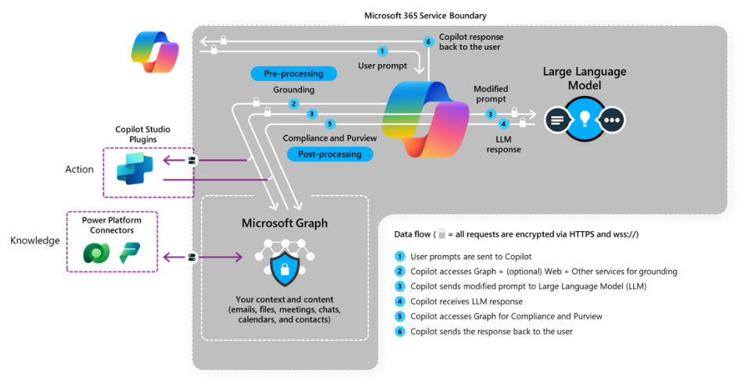
How Copilot Works
Notes:
Natural language prompting: Interact with Copilot using everyday language.
Data security and privacy within Microsoft 365.
Microsoft's commitment to responsible AI.

Slide 11
The Art of Prompting
Clear and specific prompts are key to getting the best results.
Examples of effective prompts:
Summarize this document and list the key action items.
Generate three alternative subject lines for this email.
The importance of context.

Slide 12
Core Elements of an Effective Prompt
Notes:
Overview and four pillars, Goal: Defining the task, Context: Providing background, Source: Specifying information sources, Expectations: Output format and style, Quick check: Identifying elements

Slide 13

Core Elements of an Effective Prompt
Goal
Context
Source
Expectations

Slide 14
Goal
What do we want?
Use strong verbs.
Summarize
Draft
Create
Generate
Explain
Be specific.
Notes:
1. The Goal
What it is: This is the primary task you want the AI to accomplish. It defines the core action or purpose of your request.
Why it's important: It tells the AI exactly what you want to achieve. A clear goal prevents the AI from providing a general or irrelevant response.
Example: "Write a press release." (This is a clear goal.)

Slide 15
Context
Supporting details:
Role
Target audience
Purpose
Previous conversations
Specific dates
Notes:
The Context
What it is: This is the background information and reasoning behind your request. It helps the AI understand the purpose and significance of the task.
Why it's important: Context allows the AI to make more informed decisions about the content, tone, and focus of its output. It tells the AI "why" you are asking for something.
Example: "The press release is to announce our company's new partnership with a non-profit organization focused on environmental sustainability. This is a major corporate social responsibility initiative."

Slide 16
Source
Where to get information:
Documents
Emails
Chat Threads
OneDrive/SharePoint
Internet
Notes:
The Source
What it is: This is the specific data or documents the AI should reference to inform its response. This is particularly useful in Copilot, which can ground its responses in your company's data.
Why it's important: Providing a source ensures the AI's response is accurate, factually correct, and consistent with your specific information. It prevents the AI from making up information or using generic data.
Example: "Please use the key details from the 'Partnership Agreement Q2 2025' document to get the correct names, dates, and mission statements."

Slide 17
Expectations
Specify the output:
Format
Length
Tone
Style
Review and verify
Notes:
The Expectation
What it is: This defines the specific requirements for the final output. It covers the format, tone, length, and any other structural or stylistic details.
Why it's important: It ensures the AI's response meets your exact needs, minimizing the need for extensive edits and revisions. It tells the AI "how" you want the response to look and feel.
Example: "The press release should be professional and inspiring. It must be no more than 400 words and should include a quote from our CEO and a quote from the non-profit's director. It should be formatted with a clear headline and subheadings."

Slide 18
Sample Prompts
Write an email to Frank.
Prompt Elements:
Goal
Context
Source
Expectations
Notes:
Goal…and not much else

Slide 19
Sample Prompts
Create a presentation outline based on the 'Q3 Sales Report.docx' document, focusing on the key achievements and challenges.
Prompt Elements:
Goal
Context
Source
Expectations
Notes:
All four

Slide 20
Sample Prompts
Write a press release to announce our company's new partnership with a non-profit organization focused on environmental sustainability. The press release should be professional and inspiring, no more than 400 words, and include a quote from our CEO and a quote from the non-profit's director. Please use the key details from the 'Partnership Agreement Q2 2025' document to ensure all facts are accurate.
Prompt Elements:
Goal
Context
Source
Expectations
Notes:
All four

Slide 21
Best Practices for Writing Prompts
Notes:
General tips and strategies, Be specific and use natural language, Iterate, refine, and provide positive instructions, Break down tasks and experiment, Review and verify outputs

Slide 22

Best Practices for Writing Prompts
Be specific and clear.
Lead with positive instructions.
Break down complex tasks.
Specify a persona.
Provide examples.
Iterate and refine.
Review and verify.
Notes:
Writing an effective prompt is the key to getting the best possible results from an AI like Microsoft Copilot. A well-crafted prompt gives the AI clear instructions, context, and constraints, ensuring a relevant and high-quality response.
Here are the best practices for writing prompts, combining a core framework with additional tips for success.
1. Use the "G-C-S-E" Framework
This is the foundational model for every great prompt. Ensure you include these four elements whenever possible.
Goal: State the primary task you want the AI to accomplish. (e.g., "Write a blog post...")
Context: Provide the background information. (...for an internal company newsletter about our new work policy.")
Source: Direct the AI to a specific document or data set to reference. ("...Please use the attached PDF 'Hybrid Work Policy 2024' as a source.")
Expectation: Define the format, tone, and specific requirements for the output. (...The tone should be encouraging and professional, no more than 500 words, and structured with an intro, three main points, and a conclusion.")
2. Be Specific and Detailed
Vague prompts lead to vague answers. The more specific you are, the better the AI can tailor its response. Avoid open-ended requests that lack clear direction.
Instead of: "Write about customer service."
Try: "Write a 300-word article on how to handle difficult customer service calls, focusing on active listening and de-escalation techniques. The audience is new call center employees."
3. Use Positive Instructions
Tell the AI what "to do" rather than what "not to do." This is more effective as it gives the AI a clear path to follow.
Instead of: "Do not mention our competitors in the press release."
Try: "Focus the press release exclusively on our product's unique features."
4. Break Down Complex Tasks
For multi-step or highly complex requests, it's often more effective to use a series of prompts. Start with a broad request and then refine the output with follow-up prompts.
Step 1: "Generate an outline for a sales training manual on objection handling."
Step 2: "Expand the section on 'common objections' and provide three example scripts for each."
Step 3: "Rewrite the introduction to be more inspiring and motivational."
5. Specify a Persona or Role
Assigning a persona to the AI helps it adopt the appropriate voice and perspective for the task.
Instead of: "Explain a new marketing strategy."
Try: "Act as a senior marketing director and explain the new product launch strategy to a team of junior managers."
6. Provide Examples
If you have a specific style or format in mind, include an example in your prompt. This gives the AI a template to follow.
Prompt: "Write a product description for our new laptop. Here is an example of the style I like: 'The new Stellar-X drone is sleek, powerful, and ready for adventure. Capture stunning aerial footage with its 4K camera and fly for up to 30 minutes on a single charge.'"
7. Iterate and Refine
The first response may not be perfect. Use a conversational approach to refine the output. Think of it as a collaboration.
"This is a good start, but can you make the tone more formal?"
"Expand on the second bullet point and provide more detail."
"Please shorten this paragraph to two sentences."

Slide 23
Let’s try writing some prompts!
Notes:
Scenario-Based Prompting (10 min): Provide 2-3 simple scenarios relevant to common workplace tasks (e.g., "You need to summarize a long email thread about a client project," "You need to draft a thank-you note for a meeting," "You need to brainstorm ideas for a team-building event").

Slide 24
Next Steps and Action Items
Where do we go from here?

Slide 25
Section title
Next Steps and Action Items
Be sure to:
Use Copilot Chat and write more prompts
Complete survey
Monitor the Copilot SharePoint Site
Copyright 2025 Pearson. All rights reserved.
Notes:
Use script and share links

Slide 26
Thank You!

